Slide 1

Used Car Sales
Dharit Sura

Slide 2
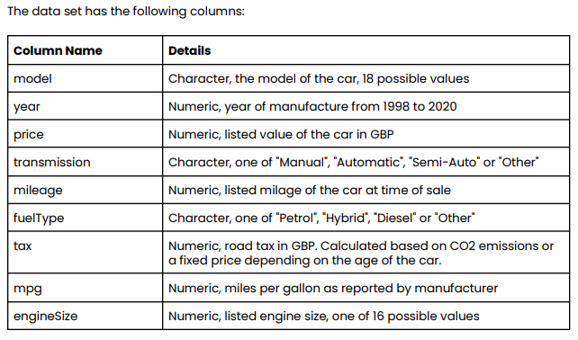
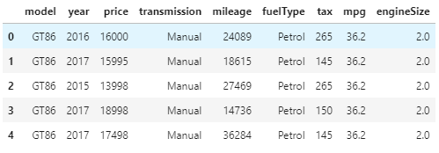
Dataset

Slide 3
Insights about the data
 | year | price | mileage | tax | mpg | engineSize
count | 6738.000000 | 6738.000000 | 6738.000000 | 6738.000000 | 6738.000000 | 6738.000000
mean | 2016.748145 | 12522.391066 | 22857.413921 | 94.697240 | 63.042223 | 1.471297
std | 2.204062 | 6345.017587 | 19125.464147 | 73.880776 | 15.836710 | 0.436159
min | 1998.000000 | 850.000000 | 2.000000 | 0.000000 | 2.800000 | 0.000000
25% | 2016.000000 | 8290.000000 | 9446.000000 | 0.000000 | 55.400000 | 1.000000
50% | 2017.000000 | 10795.000000 | 18513.000000 | 135.000000 | 62.800000 | 1.500000
75% | 2018.000000 | 14995.000000 | 31063.750000 | 145.000000 | 69.000000 | 1.800000
max | 2020.000000 | 59995.000000 | 174419.000000 | 565.000000 | 235.000000 | 4.500000

Slide 4
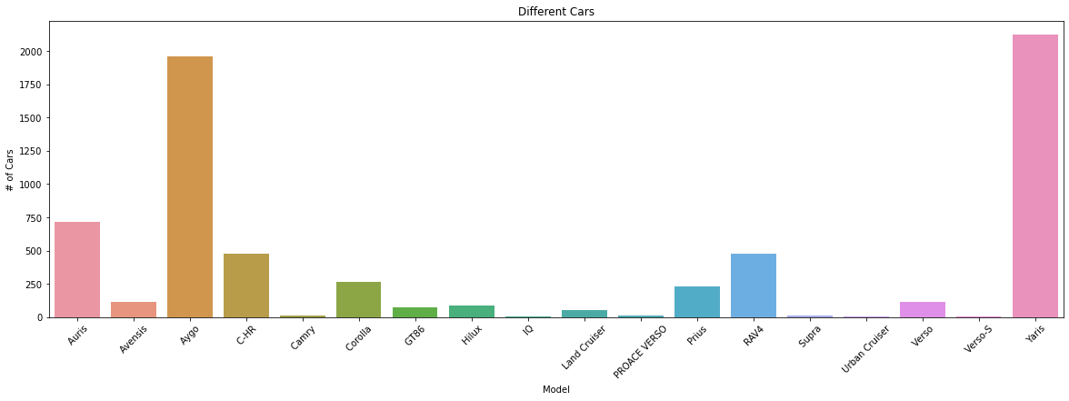
Car Models

Slide 5
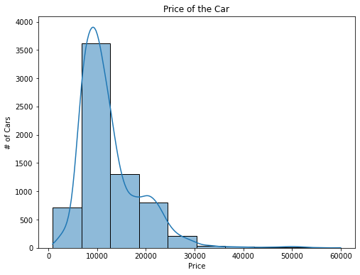
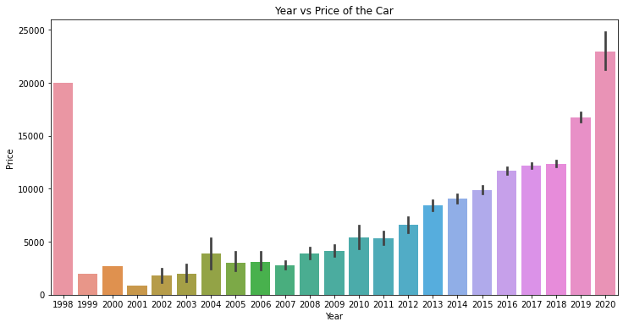
Price relationship with others
Majority of the cars are between 8500 – 12500.
Newer year cars are relatively more expensive (as expected)

Slide 6
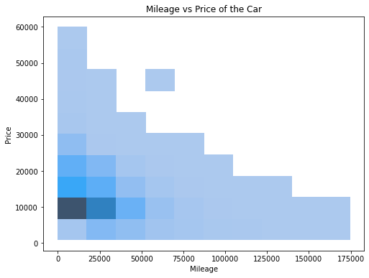
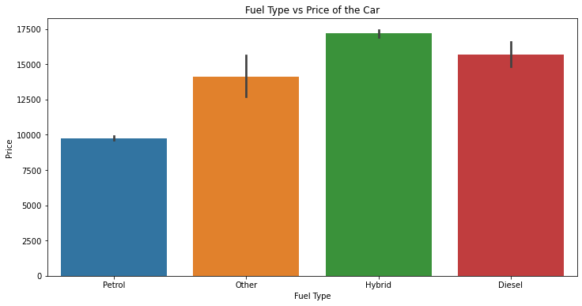
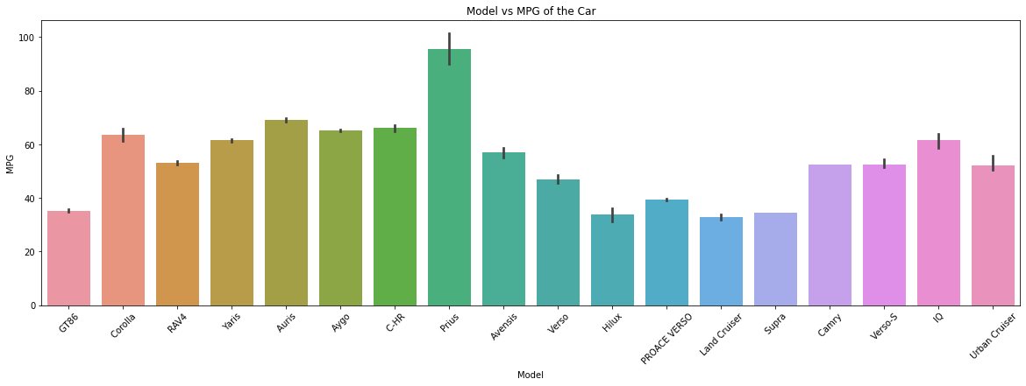

Slide 7
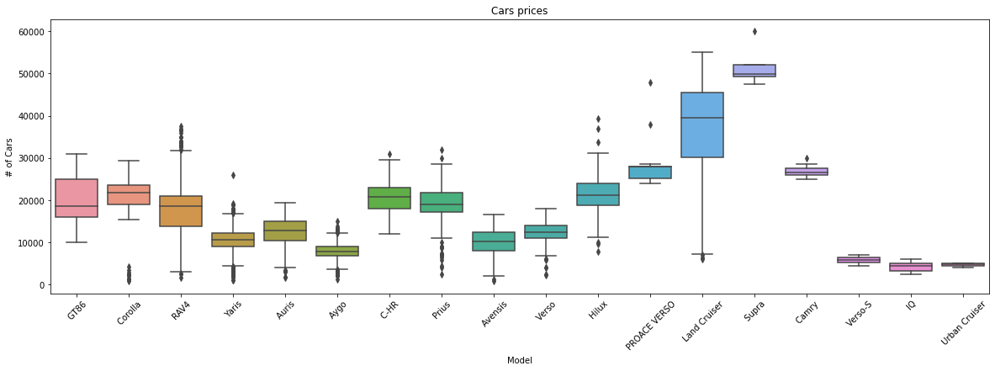
Car Model prices

Slide 8
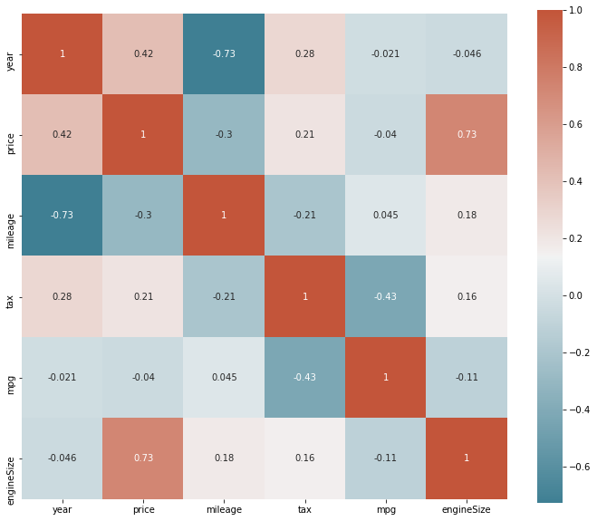
Correlation with Price

Slide 9
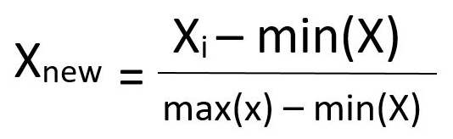
Data preprocessing
FuelType
Petrol
Other
Hybrid
Diesel
Petrol | Other | Hybrid | Diesel
1 | 0 | 0 | 0
0 | 1 | 0 | 0
0 | 0 | 1 | 0
0 | 0 | 0 | 1
Categorical variables we are going to convert them to numerical values using OneHotEncoder which is described by the image
Numerical values are scaled between the range of 0 to 1. Since the values can be vastly different.

Slide 10
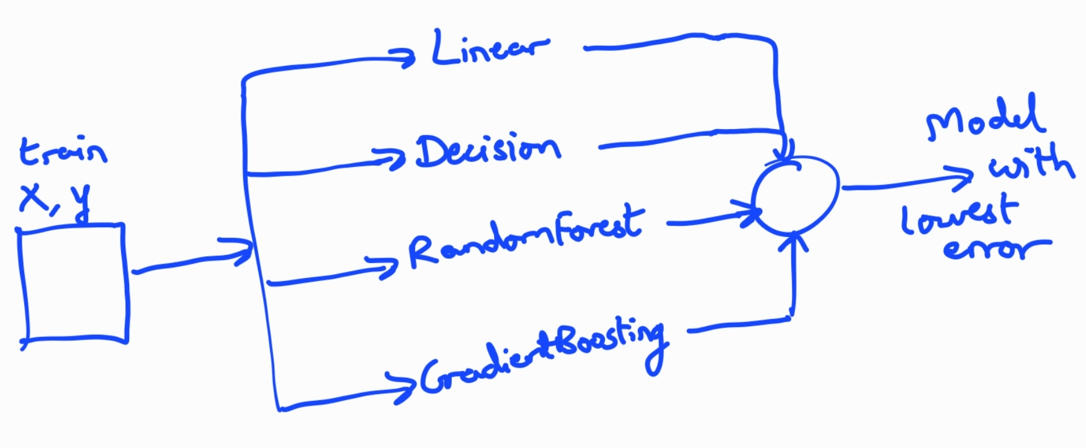
Training Data with ML Algorithms

Slide 11
Summary
We seen the way how the prices of the cars vary and what factors do they depend on.
By using various ML algorithms, we have achieved a low error rate. Thus, helping the Sales team to better price, the cars from different models to mileage and year.
Car Price Predictions Notebook

